Slide 1
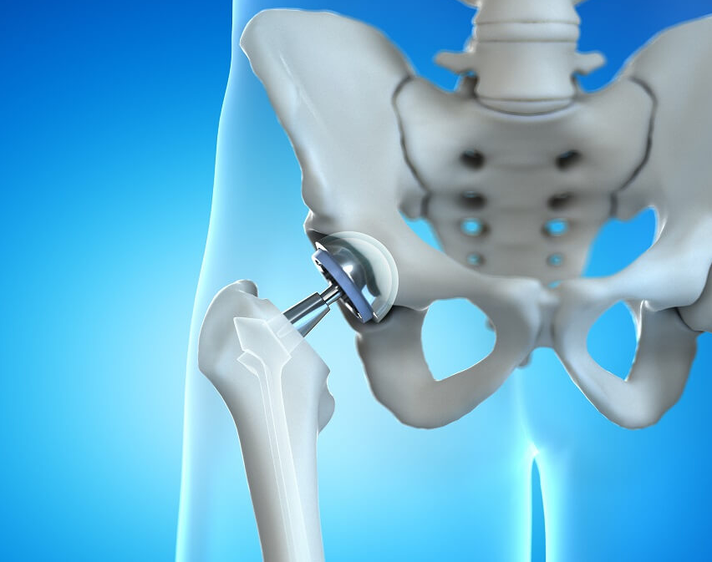
Noise Reduction from an Acoustic Signature of a Total Hip Arthroplasty
Tamir Shoresh Dan Goren
Dr. Hadas Lapid

Slide 2
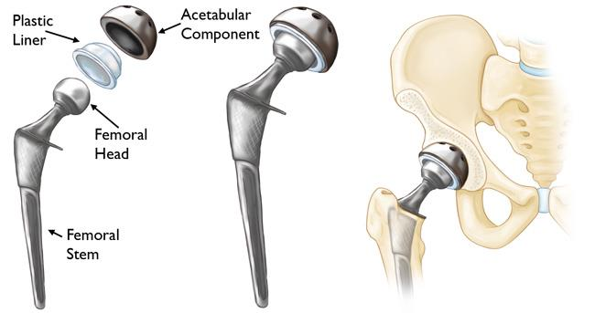
Introduction
The tactic used by orthopedic surgeons to determine optimal endpoint of broach insertions is by listening to acoustic cues.
The subjective nature of this tactic may cause imperfections, risking an improper fixation.
The main goal – replace subjective-based decisions with automated decisions

Slide 3
The Aim Of This Study
When processing THA acoustic recordings, one must consider the background noise of the operating room.
This study proposes using a spectral over-subtraction filter on the recordings, aimed to maximize the post-filter energy of the hammer-on-broach signal while minimizing the post-filter energy of the noise.

Slide 4
Method

Slide 5
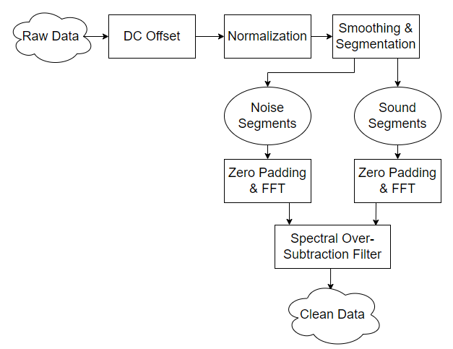
The Proposed Pipeline

Slide 6
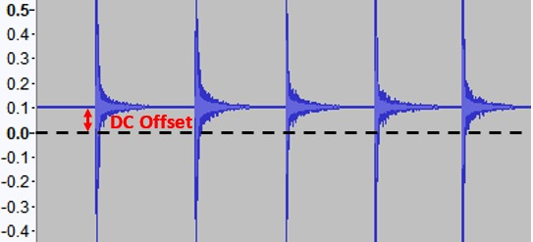

DC offset
Different types of audio cards may add varying DC (Direct Current) components to the recorded audio signal
DC components negatively influence the computation
$s`\left(n\right)= s\left(n\right)−μ_{s}$

Slide 7
Normalization
We normalize after the DC offset filter because this operation affects the signal directly.
This is done before segmentation in order to maintain the original proportion between signal energy and noise energy.

Slide 8
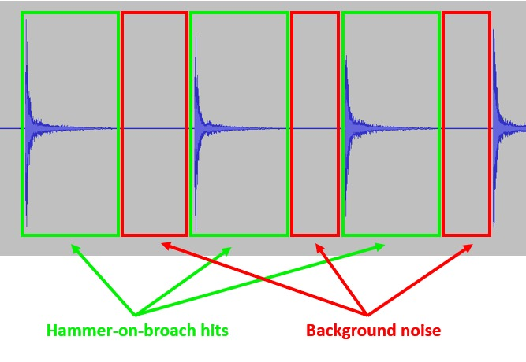
Smoothing and Segmentation
Smooth signal with a Hanning window of 501 samples in order to find the location of peaks
Find indices for start-end of each hit:
Start – 99% decay
End – max(99% decay, 140 [msec])
No overlaps allowed
Extract segments of hit sounds
Use remaining segments as noise (segments > 200 [msec])

Slide 9
Zero Padding & FFT
The denoising filter will be implemented in the frequency domain
Sound and noise intervals vary in length - to maintain a constant resolution of 1[Hz], pad with zeros such that the length of all segments is 200,000 samples.
After zero padding, each signal undergoes an FFT.

Slide 10

Spectral Subtractive-type Algorithms
noisy signal = wanted signal + independent noise:
$$\left(1\right) y\left(n\right)=s\left(n\right)+d(n)$$
The signal is assumed to be uncorrelated with the background noise, hence the power spectrum of y(n) has no cross-terms
the signal magnitude can be estimated by subtracting a noise estimate from the noisy signal:
$${\left(2\right) \left|S(ω)\right|}^{2}= {\left|Y(ω)\right|}^{2}− {\left|D(ω)\right|}^{2}$$
The signal phase remains the same - calculated from the FFT of y(n)
The noise spectrum can be estimated by:
$${\left(3\right) \left|\hat{D}\left(ω\right)\right|}^{2}= \frac{1}{M}\sum_{j=0}^{M−1}{{\left|N_{j}(ω)\right|}^{2}}$$

Slide 11

Spectral Over-Subtraction Filter
A variant of spectral subtractive-type algorithms
2 parameters are added:
α – over-subtraction factor ($α≥1$)
β – noise spectral floor ($0≤β≪1$)
$${\left|\hat{S}(ω)\right|}^{2}= \left\{\begin{aligned}{\left|Y(ω)\right|}^{2}− {α\left|\hat{D}\left(ω\right)\right|}^{2} ; if{ \left|Y\left(ω\right)\right|}^{2}>(α+β){\left|\hat{D}\left(ω\right)\right|}^{2} \\ β{\left|\hat{D}\left(ω\right)\right|}^{2} ; else \end{aligned}\right.$$

Slide 12
Results

Slide 13
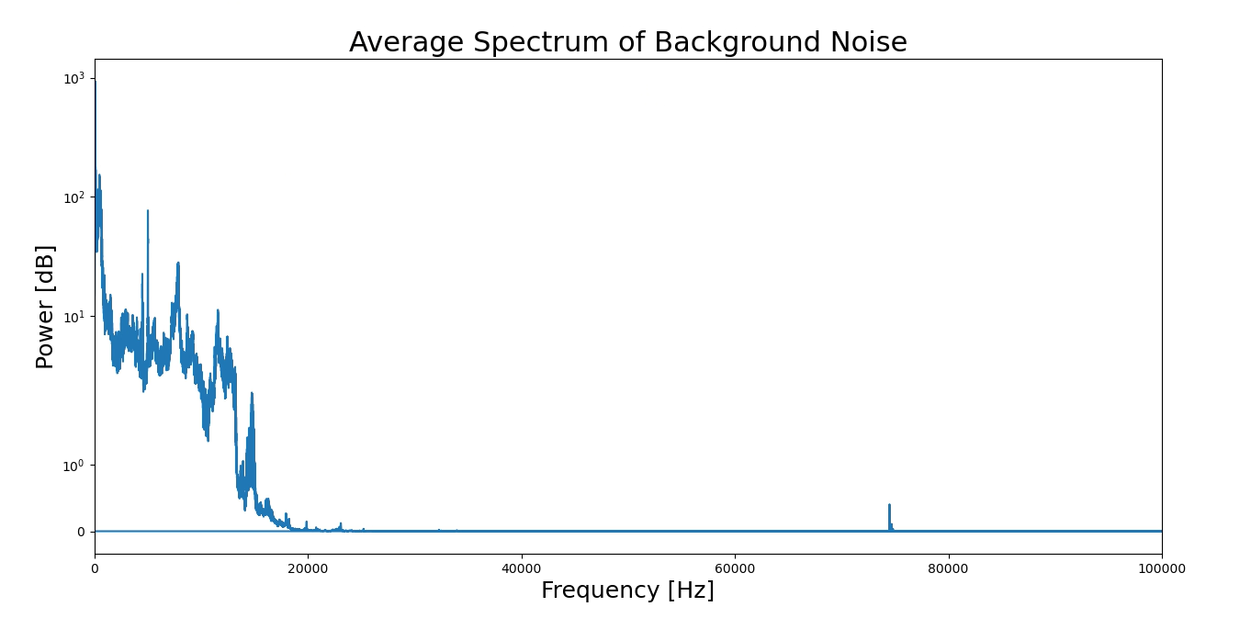
Spectral Estimation
275 input recordings → 5643 signal segments, 219 noise segments
Using the noise segments, the average spectrum distribution of the OR background noise was mapped

Slide 14
Optimizing The Filter
α | β | KPI 1 (%) | KPI 2 (%) | Difference
1 | 0 | 97.153 | 53.322 | 43.831
2 | 0 | 94.937 | 42.734 | 52.203
3 | 0 | 92.954 | 36.564 | 56.390
4 | 0 | 91.130 | 32.260 | 58.870
5 | 0 | 89.431 | 29.001 | 60.430
6 | 0 | 87.834 | 26.403 | 61.431
7 | 0 | 86.327 | 24.253 | 62.074
8 | 0 | 84.897 | 22.455 | 62.442
9 | 0 | 83.536 | 20.909 | 62.627
10 | 0 | 82.237 | 19.559 | 62.678
1 | 0.0005 | 97.154 | 53.512 | 43.642
2 | 0.0005 | 94.939 | 42.928 | 52.011
3 | 0.0005 | 92.956 | 36.760 | 56.196
4 | 0.0005 | 91.132 | 32.455 | 58.677
5 | 0.0005 | 89.432 | 29.197 | 60.235
6 | 0.0005 | 87.836 | 26.599 | 61.237
7 | 0.0005 | 86.329 | 24.449 | 61.880
8 | 0.0005 | 84.899 | 22.652 | 62.247
9 | 0.0005 | 83.538 | 21.206 | 62.332
10 | 0.0005 | 82.239 | 19.756 | 62.483
The results were evaluated using 2 KPIs:
KPI 1 - average percentage of energy remaining in signal segments after filtration, with respect to that signal energy before filtration.
KPI 2 - average percentage of energy remaining in noise segments after filtration, with respect to that noise segment’s energy before filtration.

Slide 15
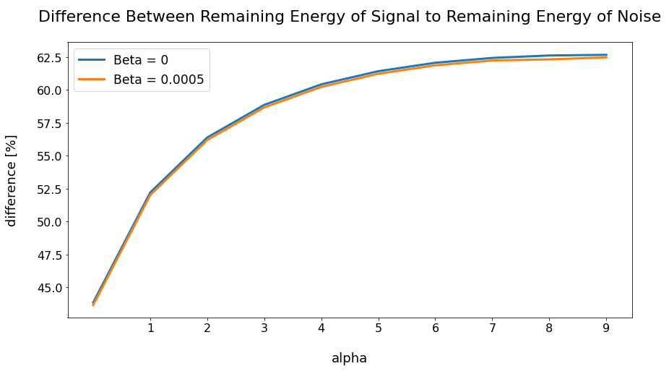
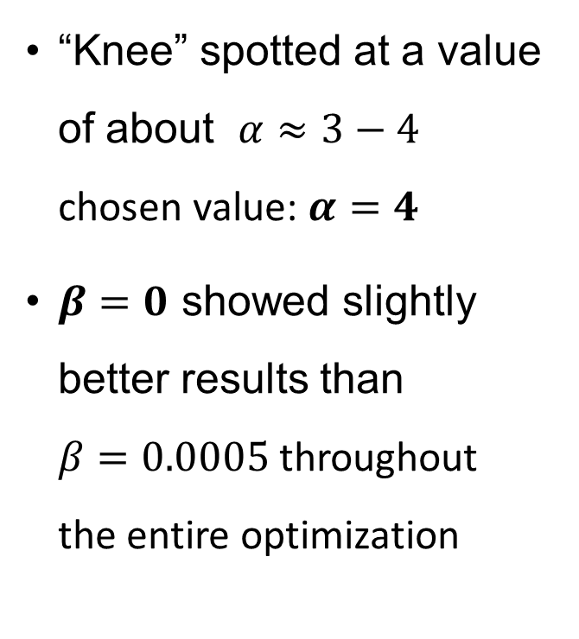
Optimization Results
“Knee” spotted at a value of about $α≈3−4$ chosen value: $α=4$
$β=0$ showed slightly better results than $β=0.0005$ throughout the entire optimization

Slide 16
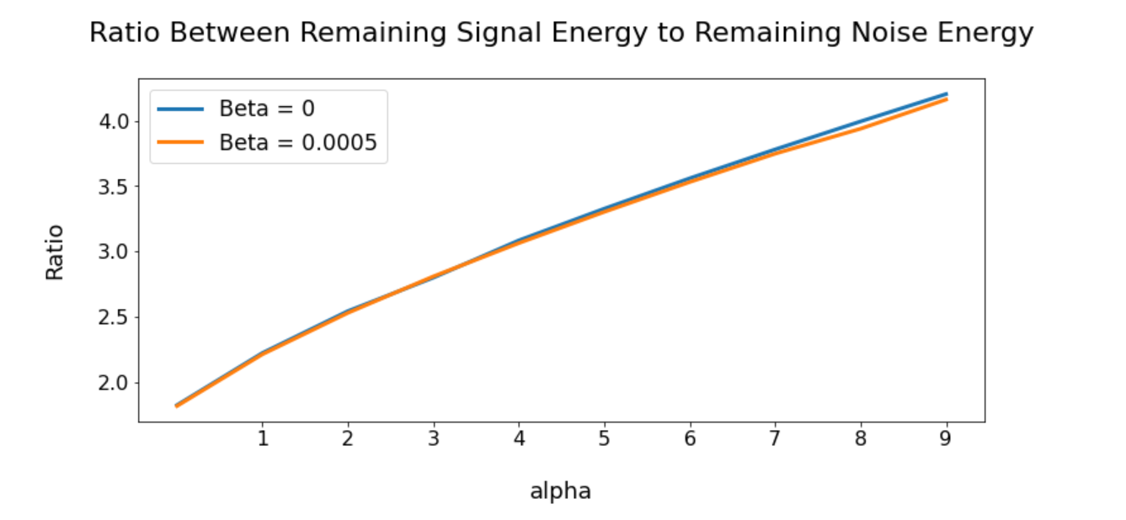

Slide 17
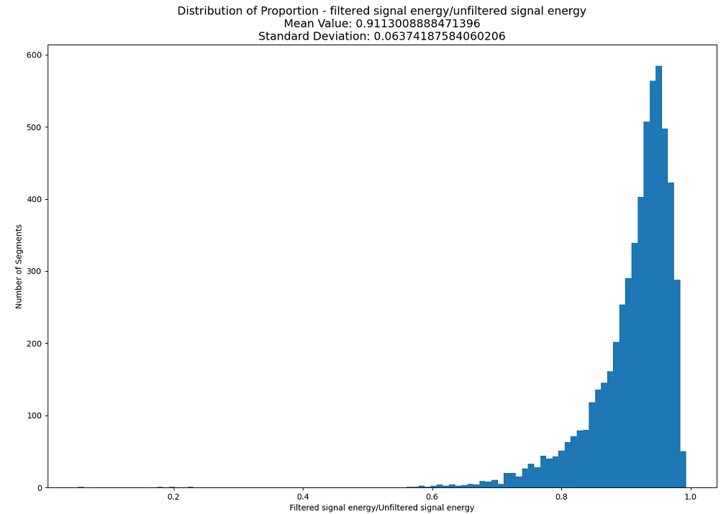
Post-Filtration Remaining Signal Energy Distribution

Slide 18
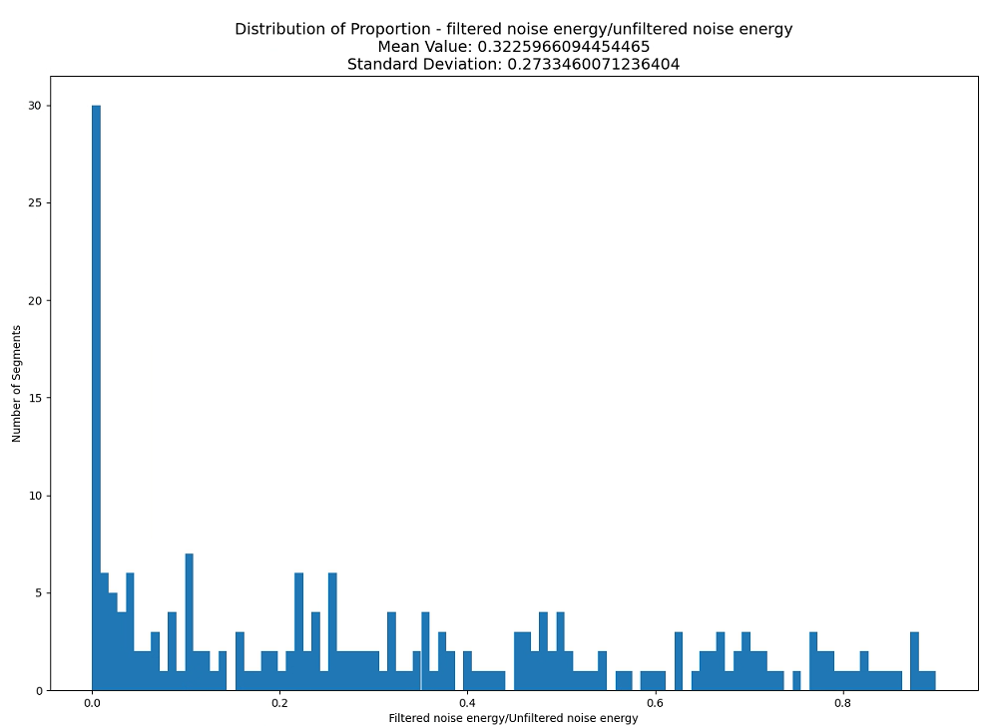
Post-Filtration Remaining Noise Energy Distribution

Slide 19
Conclusion
This study demonstrates promising results for THA acoustic signal filtration using a spectral over-subtraction algorithm.
filter out 67.74% of the noise while only losing 8.87% of signal energy.

Slide 20
Future Goals
Acquire additional recording of OR background noise independent from the signal recordings - more accurate mapping of the spectral distribution.
Test additional subtractive-type algorithms for filtration.

Slide 21
Questions?

